Slide 1
Lecture 5
Software Requirements
Muhammad Qasim
BSCS (Software Engineering-I) SZABIST-Islamabad

Slide 2
What is requirement
A requirement is a singular documented physical or functional need that a particular design, product or process aims to satisfy.
It may range from a high-level abstract statement of a service or of a system constraint to a detailed mathematical functional specification
BSCS (Software Engineering-I) SZABIST-Islamabad

Slide 3
Requirement Engineering
Requirements engineering refers to the process of defining, specifying, documenting and maintaining requirements in the engineering design process. It is a common role in systems engineering and software engineering.
BSCS (Software Engineering-I) SZABIST-Islamabad

Slide 4
Requirements Engineering Process
Inception
Elicitation
Elaboration
Negotiation
Specification
Validation
Requirements Management
BSCS (Software Engineering-I) SZABIST-Islamabad

Slide 5
Inception
Ask a set of questions that establish …
  basic understanding of the problem
  the people who want a solution
  the nature of the solution that is desired, and
  the effectiveness of preliminary communication and collaboration between the customer and the developer
Identify stakeholders
  “who else do you think I should talk to?”
Recognize multiple points of view
Work toward collaboration
The first questions
  Who is behind the request for this work?
  Who will use the solution?
  What will be the economic benefit of a successful solution
  Is there another source for the solution that you need?
BSCS (Software Engineering-I) SZABIST-Islamabad

Slide 6
Eliciting
Eliciting - Elicit requirements from all stakeholders
Meetings are conducted and attended by both software engineers and customers.
Rules for preparation and participation are established
an agenda is suggested
a "facilitator" (can be a customer, a developer, or an outsider) controls the meeting
the goal is
  to identify the problem
  propose elements of the solution
  negotiate different approaches, and
  specify a preliminary set of solution requirements
BSCS (Software Engineering-I) SZABIST-Islamabad

Slide 7
Elaboration
Elaboration - create an analysis model that identifies data, function and behavioral requirements
Analysis is performed using analysis model
  Usecase diagram
  Activity diagram
  Class diagram
  State diagram
  Dataflow diagram
BSCS (Software Engineering-I) SZABIST-Islamabad

Slide 8
Negotiating
Negotiation - agree on a deliverable system that is realistic for developers and customers
Identify the key stakeholders
  These are the people who will be involved in the negotiation
Determine each of the stakeholders “win conditions”
  Win conditions are not always obvious
Negotiate
  Work toward a set of requirements that lead to “win-win”
BSCS (Software Engineering-I) SZABIST-Islamabad

Slide 9
Specification
Specification—can be any one (or more) of the following:
  A written document
  A set of models
  A formal mathematical
  A collection of user scenarios (use-cases)
  A prototype
BSCS (Software Engineering-I) SZABIST-Islamabad

Slide 10
Validation- I
  Errors: errors in content or interpretation
  Clarification: areas where clarification may be required
  Consistent: Is each requirement consistent with the overall objective for the system/product?
  Unambiguous: Is each requirement bounded and unambiguous?
  Conflict: Do any requirements conflict with other requirements?
Achievable: conflicting or unrealistic (unachievable) requirements? Is each requirement achievable in the technical environment that will house the system or product?
Testable: Is each requirement testable, once implemented?
Completeness: missing information? Does the requirements model properly reflect the information, function and behavior of the system to be built.
BSCS (Software Engineering-I) SZABIST-Islamabad

Slide 11
Validation- II
Patterns: Have requirements patterns been used to simplify the requirements model. Have all patterns been properly validated? Are all patterns consistent with customer requirements?
Proper Abstraction: Have all requirements been specified at the proper level of abstraction? That is, do some requirements provide a level of technical detail that is inappropriate at this stage?
Extra Features: Is the requirement really necessary or does it represent an add-on feature that may not be essential to the objective of the system?
Attribution: Does each requirement have attribution? That is, is a source (generally, a specific individual) noted for each requirement?
BSCS (Software Engineering-I) SZABIST-Islamabad

Slide 12
Requirement Management
Requirements management - is the process of documenting, analyzing, tracing, prioritizing and agreeing on requirements and then controlling change and communicating to relevant stakeholders. It is a continuous process throughout a project.
BSCS (Software Engineering-I) SZABIST-Islamabad

Slide 13
Requirement Definition
A software requirements definition is an abstract description of the services which the system should provide and the constraints under which the system must operate.
There are three types of major problem with requirements definitions written in natural language :
  (1) Lack of clarity
  (2) Requirements confusion
  (3) Requirements amalgamation
BSCS (Software Engineering-I) SZABIST-Islamabad

Slide 14
Requirement Specification
Requirements specifications add further information to the requirements definition.
Natural language is often used to write requirements specifications.
There are various alternatives to the use of natural language which add structure to the specification and which should reduce ambiguity.
  (1) Structured natural language
  (2) Design description language
  (3) Requirements specification language
  (4) Graphical notations
  (5) Mathematical specifications
BSCS (Software Engineering-I) SZABIST-Islamabad

Slide 15
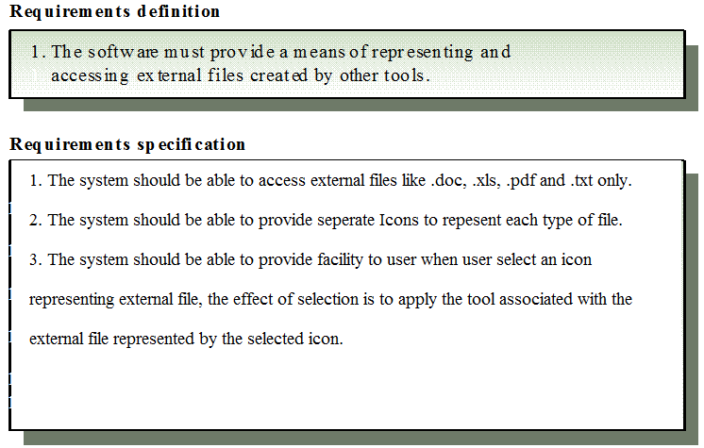
Definition and Specification
BSCS (Software Engineering-I) SZABIST-Islamabad

Slide 16
Types of Requirements
There are two types of requirements
  Functional Requirements
  Non-Functional Requirements
BSCS (Software Engineering-I) SZABIST-Islamabad

Slide 17
Functional Requirements
Requirements, which are related to functional aspect of software fall into this category.
They define functions and functionality within and from the software system.
EXAMPLES
  Search option given to user to search from various invoices.
  User should be able to mail any report to management.
  Users should be able to login into system to access further features.
BSCS (Software Engineering-I) SZABIST-Islamabad

Slide 18
Non-Functional Requirements
Requirements, which are not related to functional aspect of software, fall into this category. They are implicit or expected characteristics of software, which users make assumption of.
Example:
  Security
  Performance
  Cost
  Flexibility
  Disaster recovery
  Accessibility
BSCS (Software Engineering-I) SZABIST-Islamabad

Slide 19
Non-Functional Requirements
Product requirements
  Requirements which specify that the delivered product must behave in a particular way e.g. execution speed, reliability, etc.
Organisational requirements
  Requirements which are a consequence of organisational policies and procedures e.g. process standards used, implementation requirements, etc.
External requirements
  Requirements which arise from factors which are external to the system and its development process e.g. interoperability requirements, legislative requirements, etc.
BSCS (Software Engineering-I) SZABIST-Islamabad

Slide 20
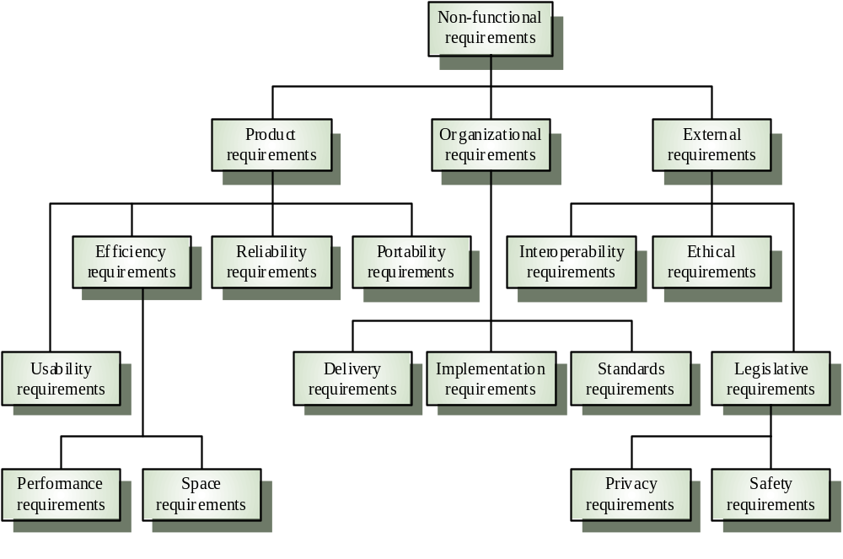
Non-Functional Requirements
BSCS (Software Engineering-I) SZABIST-Islamabad

Slide 21
Requirement Categorization
Requirements are categorized logically as
Must Have : Software cannot be said operational without them.
Should have : Enhancing the functionality of software.
Could have : Software can still properly function with these requirements.
Wish list : These requirements do not map to any objectives of software.
While developing software, ‘Must have’ must be implemented, ‘Should have’ is a matter of debate with stakeholders and negation, whereas ‘could have’ and ‘wish list’ can be kept for software updates.
BSCS (Software Engineering-I) SZABIST-Islamabad

Slide 22
User & System Requirements
User requirements talk about the problem domain, the world of the user. They describe what effects need to be achieved. These effects are the combined responsibility of the software, the hardware, and the users.
System requirements talk about the solution domain, the world of the software logic. They describe what the software must do (as opposed to the effects in the user's world that this may or may not achieve).
BSCS (Software Engineering-I) SZABIST-Islamabad

Slide 23
User & System Requirements Example
For instance for a bookkeeping software,
The user requirement is to compute the correct revenue.
The system requirement is only to compute the correct sum of the partial revenues entered by the user.
If the user enters incorrect partial revenues the software is not required to magically correct them: The output will be the correct sum of the inputs, but not the correct overall revenue.
BSCS (Software Engineering-I) SZABIST-Islamabad

Slide 24
User & System Requirements Example
User Requirement:
The MHC-PMS shall generate monthly management reports showing the cost of drugs prescribed by each clinic during that month.
System Requirements:
On the last working day of each month, a summary of the drugs. prescribed, their cost, and the prescribing clinics shall be generated. 1.2. The system shall automatically generate the report for printing after 17.30 on the last working day of the month
BSCS (Software Engineering-I) SZABIST-Islamabad

Slide 25
User Interface Requirements
UI is an important part of any software or hardware or hybrid system. A software is widely accepted if it is -
  easy to operate.
  quick in response.
  effectively handling operational errors.
  providing simple yet consistent user interface.
BSCS (Software Engineering-I) SZABIST-Islamabad

Slide 26
Software Requirements Specification
A software requirements specification (SRS) is a description of a software system to be developed. It lays out functional and non-functional requirements, and may include a set of use cases that describe user interactions that the software must provide.
BSCS (Software Engineering-I) SZABIST-Islamabad

